Slide 1
Before we begin…
Do you have snacks/fluids?
Have you created your personal AWS account?

Slide 2
Cloud Network Security
Using AWS Day 1

Slide 3

Notes:
Before beginning we would like to acknowledge the Traditional Owners of country throughout Australia and recognise their continuing connection to land, waters and culture.
I am presenting from the lands of the Wurundjeri people and I wish to acknowledge them as Traditional Owners. I also acknowledge the fact that we are spread out and pay I respects to all Traditional Owners from all areas where we have gathered from today. This includes Elders, past, present and emerging as well as any Aboriginal Elders of other communities who may be joining us today.

Slide 4
Currently responsible for supporting Seek’s Shared Cloud Networking solutions!
Co-Organiser for DevOps Girls
‘Fell’ into Cloud Networking, but LOVE it!
Passionate about diversity, inclusion and non-traditional pathways to technology
Always learning
Hello, I’m Franca
Platform Engineer @ SEEK

Slide 5
Bec our Teaching Assistant

Slide 6

Code of Conduct
Questions:
“raise your hand” 🙋🏿‍♀️
Post in the chat 🆘
Practical help:
Ask your group first
We’ll cycle through the breakout groups
Bring your questions back to the group
Fight virtual fatigue
Photos 💚 / ❤️
Inclusive
Judgement-free
No feigning surprise
No “well actuallys”
No back-seat driving
No subtle “isms”
Notes:
Two ways to ask questions:
‘raise your hand’
Or post it in the chat
Practical help
- ask your group
We’ll cycle through the breakout rooms and ask if anyone needs help
Still outstanding Q’s: raise it when we’re all back together
No feigning surprise
The first rule means you shouldn't act surprised when people say they don't know something. This applies to both technical things ("What?! I can't believe you don't know what the stack is!") and non-technical things ("You don't know who RMS is?!"). Feigning surprise has absolutely no social or educational benefit: When people feign surprise, it's usually to make them feel better about themselves and others feel worse. And even when that's not the intention, it's almost always the effect. As you've probably already guessed, this rule is tightly coupled to our belief in the importance of people feeling comfortable saying "I don't know" and "I don't understand."
No well-actually's
A well-actually happens when someone says something that's almost - but not entirely - correct, and you say, "well, actually…" and then give a minor correction. This is especially annoying when the correction has no bearing on the actual conversation. This doesn't mean the Recurse Center isn't about truth-seeking or that we don't care about being precise. Almost all well-actually's in our experience are about grandstanding, not truth-seeking. (Thanks to Miguel de Icaza for originally coining the term "well-actually.")
No back-seat driving
If you overhear people working through a problem, you shouldn't intermittently lob advice across the room. This can lead to the "too many cooks" problem, but more important, it can be rude and disruptive to half-participate in a conversation. This isn't to say you shouldn't help, offer advice, or join conversations. On the contrary, we encourage all those things. Rather, it just means that when you want to help out or work with others, you should fully engage and not just butt in sporadically.
No subtle -isms
Our last social rule bans subtle racism, sexism, homophobia, transphobia, and other kinds of bias. This one is different from the rest, because it covers a class of behaviors instead of one very specific pattern.
Subtle -isms are small things that make others feel unwelcome, things that we all sometimes do by mistake. For example, saying "It's so easy my grandmother could do it" is a subtle -ism. Like the other three social rules, this one is often accidentally broken. Like the other three, it's not a big deal to mess up – you just apologize and move on.
If you see a subtle -ism at the Recurse Center, you can point it out to the relevant person, either publicly or privately, or you can ask one of the faculty to say something. After this, we ask that all further discussion move off of public channels. If you are a third party, and you don't see what could be biased about the comment that was made, feel free to talk to faculty. Please don't say, "Comment X wasn't homophobic!" Similarly, please don't pile on to someone who made a mistake. The "subtle" in "subtle -isms" means that it's probably not obvious to everyone right away what was wrong with the comment.

Slide 7

Who are you?
Image sourced from: https://broadlygenderphotos.vice.com/
Notes:
Who you are – where you work/study or job you’d love to nab
2 things you’d like to get out of the training
If you get time… does your group have something in common? Can you find it? How specific can you get with it?

Slide 8
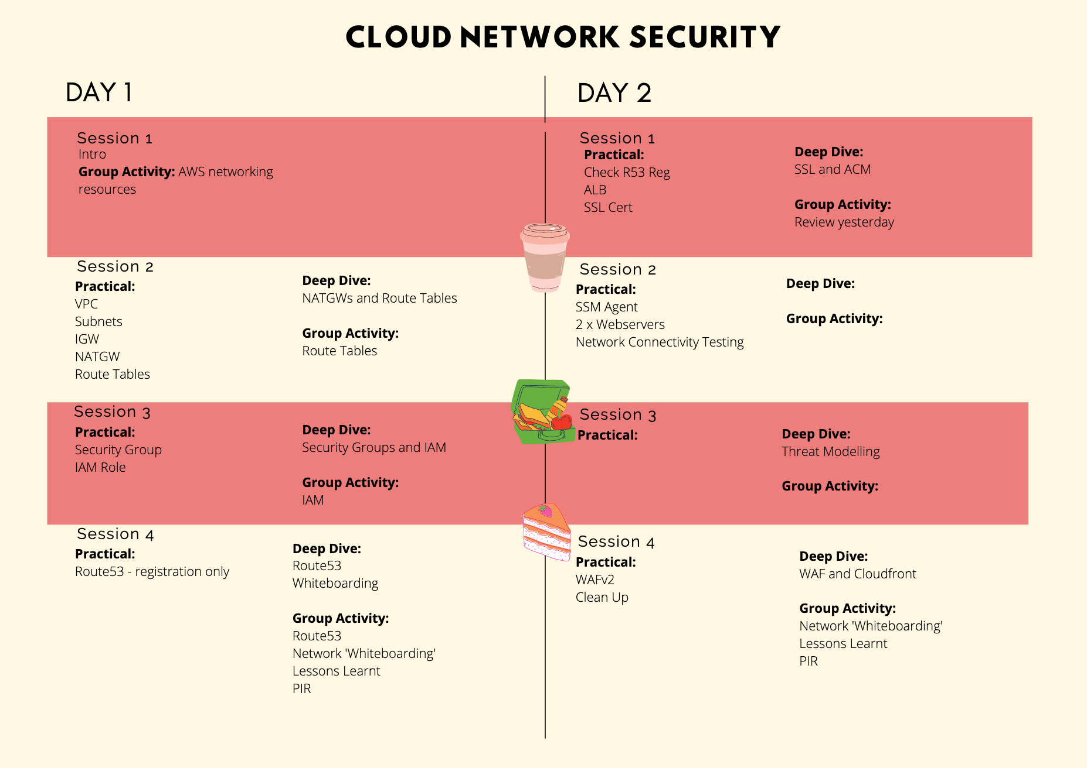
Our Agenda for the 2 days

Slide 9
What we’re NOT covering
Application security – focus will be on the AWS networking resources only
Hybrid (only if we have time)
Research methods – Blue team fun times only!
Your snowflake networking problem

Slide 10



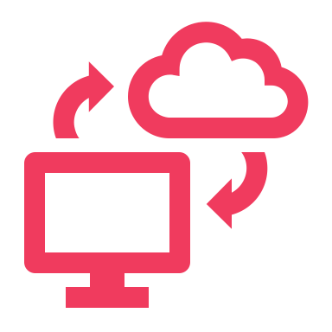
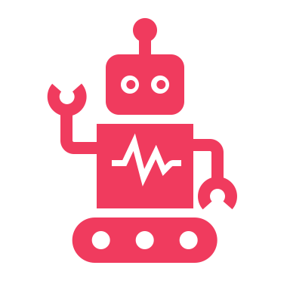

Two Modes of Learning
Theory
We’ll introduce you to some concepts and answer questions
Hands On
We’ll jump into the AWS console and start creating our cloud networks

Slide 11
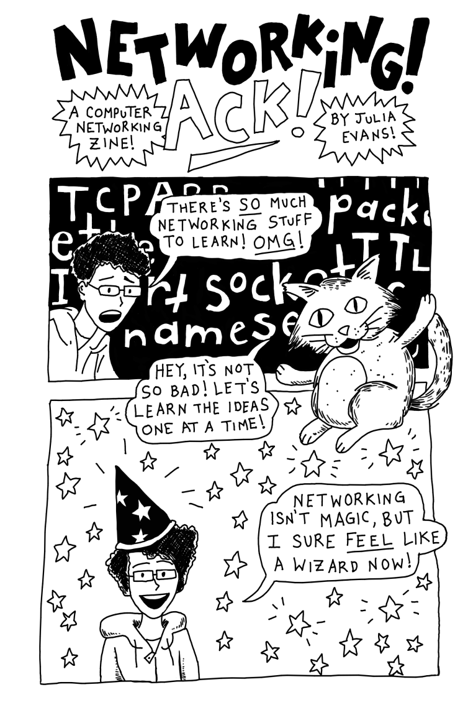
Networking 101
Digital Copy:
Jvns.ca/networking-zine.pdf
Created by Julia Evans
@b0rk
Notes:
Zine talk about Ips, CIDR ranges, SSL, ports, subnets
Examples of pages to take note of
Also: https://jvns.ca/blog/2018/07/24/ip-addresses-routing/

Slide 12
The what and why of AWS
What is AWS?
Why do we use AWS?
Over 200+ services to enable cloud based infrastructure that you can manage
One of many providers of cloud infra such as MS Azure, Google, IBM, and more
Data storage, compute power, networking, web hosting, etc
Enables scalable infrastructure in a highly secure environment
Reliable, flexible, and available
Unparalleled service offerings (150+ more than Google)
Best in class support, redundancy, and availability

Slide 13
History: What came before AWS?
Then:
Now:
Long lived, dedicated servers
Long lead times for new contracted infra
Estimated infra, often over-provisioned
Fixed hardware, low scalability
Short lived, shared services
Cost shared by consumers
Infra on demand
Virtual hardware, highly scalable

Slide 14
Shared Responsibility Model
Security OF the cloud
Hardware
Physical Access
Software e.g. NGINX EC2 image
Security IN the cloud
Application Security
Configuration of AWS Resources e.g. s3
IAM
Cloud Network Security
Notes:
AWS Data Centers:
https://aws.amazon.com/compliance/data-center/data-centers/

Slide 15
Networking OSI Model (Open Systems Interconnection)
7 Application Layer
For human consumption – what we see eg. HTTP, SNMP, FTP
6 Presentation Layer
Processes data to be used by the app layer, including encryption/decryption, jpg, SSL, TLS
5 Session Layer
4 Transportation Layer (TCP/UDP)
Responsible for transporting packets in a way that covers flow control and reliability
3 Network Layer
Routing data from A to B going across boundaries – IP’s, ICMP, IPsec, IGMP
2 Data Link Layer
How data is linked up from point A to B eg. ARP, MAC Address
1 Physical Layer
Hardware responsible for data transmission – eg the physical cables, hubs
Creation/Tear down of network connections
There is still
a lot to
configure
securely
AWS’s
Responsibility

Slide 16
Cloud Networks - AWS
22 Regions - Australia’s Region is ap-southeast-2
69 AZ’s (availability zones) There are 3 in Sydney, Australia
Every time you create a VPC, you’re using part of this network
Group Activity Time!

Slide 17
Intro to AWS Networking Resources
Defines where network traffic can go from your subnets or gateways
Isolated part of the cloud of your AWS services
Packet filter associated with a subnet
Connects your VPC to the internet
A managed AWS service that distributes traffic to targets you specify
Translates a private IP to a public IP for secure internet access for private AWS resources
A subset of your VPC
Securely connect your VPC to on-prem infrastructure/private networks
Set of rules to block/allow inbound/outbound network traffic
Determines number of IPs your VPC can have
Allow you to connect to an EC2 using an IAM role, without AWS credentials
Virtual Private Cloud (VPC)
CIDR Range
Subnets
Internet Gateway (IGW)
NAT Gateway
Direct Connect/VPN
NACL
Route Table
Security Groups
Load Balancer
Systems Manager Agent (SSM Agent)
Notes:
Reference sheet that translates between different cloud providers

Slide 18
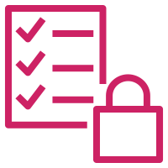


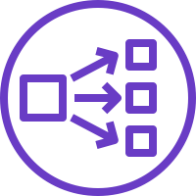
What does this look like as infra?
VPC + Subnets
Internet Gateway
Private + Public Route Table
NAT Instance
Security Groups
Public Load Balancer
Private Servers
VPC
Private Subnet
Public Subnet
Security Group
Private Subnet
Public Subnet
Web
Servers
HTTPS
Load Balancer
Internet
Public Route Table
NATG
Private Route Table
EIP/ Public IP
This white area is the rest of the internet/cloud!

Slide 19
What does this look like as infra?
VPC + Subnets
Internet Gateway
Private + Public Route Table
NAT Instance
Security Groups
Public Load Balancer
Private Servers
VPC
Private Subnet
Public Subnet
Security Group
A
Public Subnet
Private Subnet
HTTPS
Load Balancer
B
Internet
Public Route Table
This white area is the rest of the internet/cloud!

Slide 20
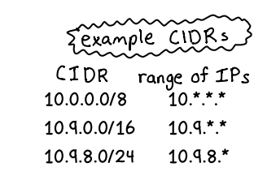
IPs and CIDR Ranges
IPs
It’s an identifying address for a routable resource.
IP addresses contain 4 octets, each consisting of 8 bits giving values between 0 and 255
CIDR (Classless Inter-Domain Routing)
A CIDR is a group of IP’s allocated to a part of your network.
Taken from Julia Evan’s zine.
As the netmask gets bigger,
you get less IPs

Slide 21
Key Terms…
Netmask
/x tells you how many IP’s are available in your CIDR – the smaller the number, the more IPs you have. E.g. /24 indicates there are 265 IP’s available
Network ID
This is part of your IP that is shared for all resources within your network. E.g. 193.164.2.44 and 193.164.2.35 are part of the same network
Host ID
This is part of your IP that is unique to one resource. E.g. 193.164.2.44 and 193.164.2.35 are IP’s for different resources

Slide 22

Subnetting
Once you know how many IP’s are available in your network, you can split this into subnets.
We will not be covering subnetting today
Play around with subnetting though:
https://cidr.xyz

Slide 23
How does this apply to our network?
10.0.0.0/16
VPC
Security Group
Private Subnet
Public Subnet
Web
Servers
HTTPS
EIP/ Public IP
Load Balancer
Internet
Public Route Table
NATG
Private Route Table
EIP/ Public IP
Known to the internet
E.g. 193.164.2.44
and 193.164.2.35
10.0.1.0/24
10.0.2.0/24

Slide 24
Let’s get into the console!
We’re going to use step-by-step guides in GitHub to build….
VPC
Public Subnet
Private Subnet

